Slide 1
Retail Digital Supply Chain
Digital Platforms Disruption
Santiago Gallino, Charles W. Evans Distinguished Faculty Scholar and Assistant Professor of Operations, Information and Decisions

Slide 2
Introduction
Understanding the digital transformation landscape
Focus on the disruption driven by digital platforms and its implications
Learn how to best position ourselves to succeed in this changing environment

Slide 3
Digital Platform Disruption
Digital platforms are not new
In many cases, these are the dominant players across different industries today

Slide 4
Digital Platform Disruption
The radical change that a platform brings to the industry can easily be overlooked
Airbnb, one of the largest accommodations providers int he world, owns no real estate
Uber, Lyft, and Didi, the leading taxi companies in the world, own no vehicles
Several of the largest retailers in the world today (Amazon, Alibaba, Mercado Libre) don’t own any retail stores
These platforms compete head to head with retailers
From the customer perspective it is unclear what the difference might be

Slide 5
Digital Platforms
What are these platforms doing?
Why are they so successful?
How are they transforming the retail industry?

Slide 6
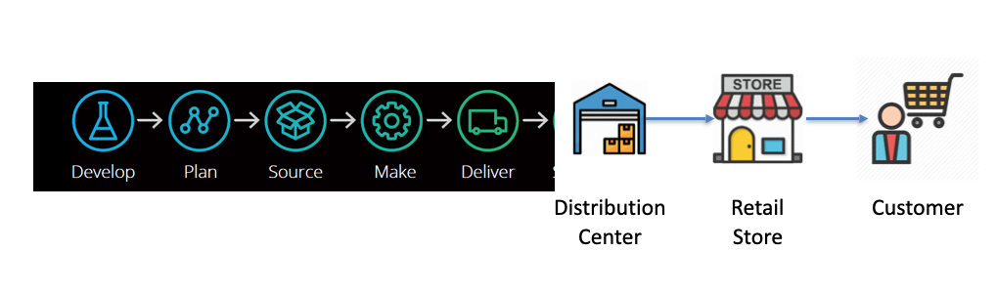
Supply Chain
Deloitte. The Customer-Driven Supply Chain, Digital supply networks enable the whatever-whenever-wherever shopping experience. 2018

Slide 7
Digital Platform Disruption
During the early days most traditional retailers built distribution centers to fulfill orders coming from the digital stores
Soon after that, the first digital platforms started to emerge
Retail platforms learned quickly that the opportunity and value creation was greater in connecting customers with sellers in the digital world than in selling the products themselves

Slide 8
The Role of Platforms
The role of platforms like Amazon or Alibaba is much more similar to the role of a mall operator than the role of a retailer
A mall operator provides the infrastructure and the services needed for both customers and sellers to meet and transact
For that service, the mall operator charges a commission to the seller
These operators are rarely involved in buying inventory, shipping products, or deciding on product prices or assortment
To the sellers, they offer a large number of visitors willing to navigate the mall looking for the next thing to buy
To the visitors, they offer a convenient location filled with the best assortment of products and services to buy

Slide 9
Successful Platforms
A successful platform needs to be attractive to both sellers and customers
From the platform’s perspective there are two customers
The end customers that will be buying the product
The seller that will display the product on the platform
The platform focuses on developing and improving the services needed for customers and sellers to have a smooth experience

Slide 10
Digital Payment Methods
A successful digital retail experience requires a state-of-the-art digital supply chain
These platforms developed digital payment methods for customers and are heavily involved in digital financing for both sellers and customers
Digital payments are a driving force in these platforms
In many countries around the world, the most common payment options were developed and fueled by a digital platform
Customers have moved away from cash payments and transitioned to an electronic payment method without ever using traditional credit cards

Slide 11
3rd Party Logistics
Retail platforms helped develop a new wave of 3rd party logistic companies
A good portion of e-commerce growth has been driven by retail platforms and their ability to develop the logistic infrastructure needed for e-commerce to thrive
The flow of products in the digital supply chain has gained a scale and speed that was hard to imagine a few years back

Slide 12
Information Flow
The information flow is at the core of the digital transformation, driven by the platform
Information availability and transparency is a key factor of their business success
Customers and sellers benefit from the information flow that occurs through the platform in an organized and frictionless fashion

Slide 13
Inventory
Unlike a traditional retailer, the platform will not need to buy inventory, set prices, or get involved in shipping the product
Possibility to carry a large number of product categories with huge variety
The assortment of the traditional e-commerce store is limited, but the relatively smaller assortment comes with the benefit of avoiding the customer getting overwhelmed by the different options

Slide 14
Inventory
Traditional retailers tend to offer, on average, better quality
Curation of the assortment
Guarantee that the product will be shipped properly and in good condition
Guarantee that the customer will not receive a counterfeit
This curation role and quality control is something that the platform has a hard time controlling and it can become a source of tension between the platform and the sellers

Slide 15
Shipping and Delivery
Often, delivery features are left to the vendors and for that reason, there is a wide range of options and outcomes
Vendors tend to focus on minimizing costs rather than offering a consistent experience for the customers
Several platforms have developed initiatives that try to mitigate this shortcoming
In some cases, the platform gets directly involved in the development of a 3rd party delivery network
In other cases, it is a thriving digital ecosystem that offers a solution to the platform, and ultimately the consumers and the vendors
When it comes to shipping, e-commerce retailers can offer a more uniform experience in terms of timing, packaging, and cost

Slide 16
Fundamental Difference Between Traditional Retailer and Platform
For the e-commerce retailer, the revenue source is based on the traditional retail format — offering the right product, in the right place, at the right price
If attractive to customers, this offering will allow the retailer to charge a markup on the products they sell
In the case of the platform, the main source of revenue comes from a commission and advertisements that the platforms charge to the vendors
It is important to notice that the radical difference in the underlying business model and the revenue streams is opaque to the end customer
However, they both compete head-to-head for the same customers

Slide 17
Digitally Integrated Brands
Brands, and especially digitally savvy brands have grown in importance over the recent years
Brands can have different roles in the digital supply chain
Traditionally, mainly focused on the design and manufacturing of products that would be sold through retail chains (Adidas, Nike, Phillips, Samsung)
Over time, several brands started to integrate forward and open their own physical retail stores
Other brands were born as an integrated brand, and from day one they were involved in all steps of the supply chain, from the design and manufacturing to the retail store (Zara, Gap, H&M, Ikea)

Slide 18
Value of Retail Stores
Years before the digital transformation of the retail sector, a good number of brands that started focusing on the first steps of the supply chain, saw the value and opportunity of retail stores
This opportunity goes beyond the increased margin or controlling the brand experience
It gives the manufacturing brand access to customers data firsthand without the need to ask retailers for this critical information
Today, most well-recognized brands will have a retail footprint that allows the company to have direct access to the end customers (Lego, Apple)

Slide 19
Value of Retail Stores
Today, brands that don’t have their own online store are more the exception than the rule
This doesn’t mean that they don’t sell through traditional retailers and platforms
It does mean that their relationship with them is more complex than before
Native digitally integrated brands have been a real disruption in the digital space

Slide 20
Retail Digital Supply Chain
The Role of the Customers
Santiago Gallino, Charles W. Evans Distinguished Faculty Scholar and Assistant Professor of Operations, Information and Decisions

Slide 21
The Role of the Customers
Early on in the digital transformation, customers were willing to search for product information online, read reviews, and become experts on those products before arriving at the physical store
Certain retail categories have rapidly moved to the purchase online space
Product categories such as books and music sell only a small fraction of the total volume in physical stores

Slide 22
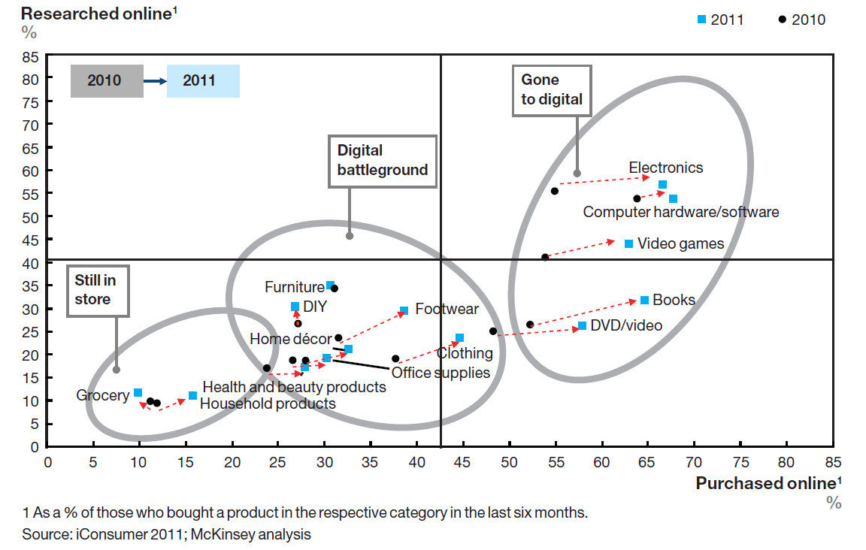
Digital Intensity 2010/2011

Slide 23
Digital Intensity
Imagine that the value of the x and y axis for each category can be added
This number, the sum of the search and purchases percentages, will give us a score that in a sense captures the digital intensity of that category
The digital intensity score for a category is always evolving, and retailers need to track the scores evolution over time

Slide 24
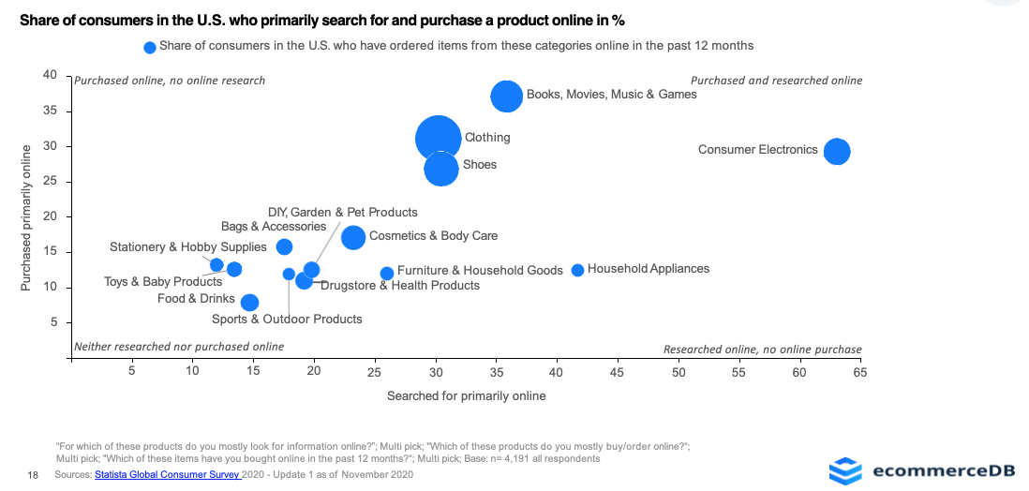
Digital Intensity 2020

Slide 25
Digital Intensity Market
In the same way that different categories present different digital intensities, different countries, regions or markets can have different retail digital intensities

Slide 26
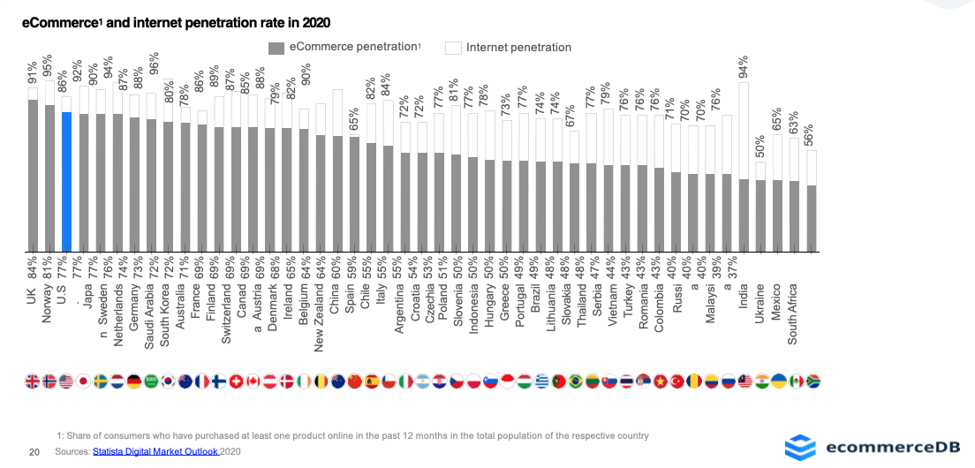
77% of the US Population Shops Online

Slide 27
Understanding the Digital Intensity
Digital Intensity Market
Low
High
High
Electronics in
South Africa
Electronics in
the U.K
Digital Intensity Category
Low

Slide 28
Retail Digital Supply Chain
The Role of the Vendors
Santiago Gallino, Charles W. Evans Distinguished Faculty Scholar and Assistant Professor of Operations, Information and Decisions

Slide 29
The Role of Vendors
From the platform’s perspective, the vendors are as fundamental as the buyers
Vendors are customers for the platform
When platform managers define or adjust commissions for the platform products, they are always keeping an eye on the impact this will have on their relationship with the vendors
They need the vendors to be happy and eager to offer all their assortment in the platform with the best customer service and the lowest possible prices

Slide 30
The Role of Vendors
This new perspective of vendors and the relationship this generates has pushed traditional retailers to revisit their approach to managing the relationships with their suppliers
These relationships can also turn unpleasant very quickly

Slide 31
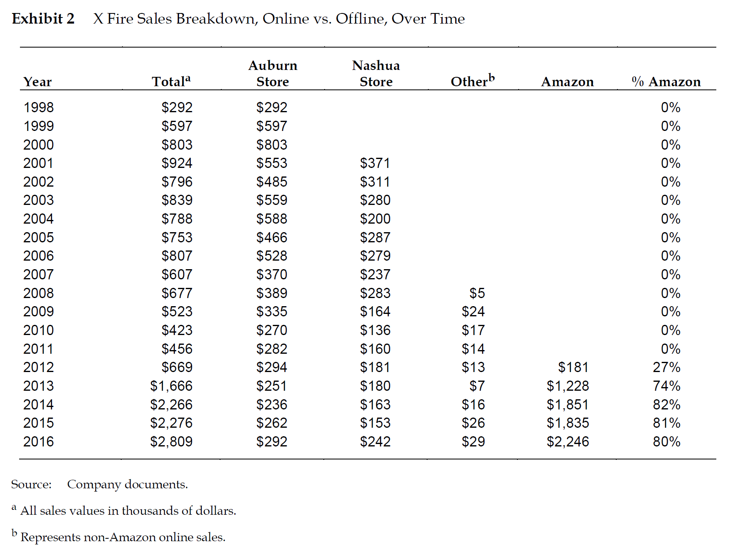

Platform/Vendor Relationship Example: X Fire
Zhu, Feng, and Angela Acocella. "X Fire Paintball & Airsoft: Is Amazon a Friend or Foe? (A)." Harvard Business School Case 617-046, January 2017. (Revised August 2019.)

Slide 32
Platform/Vendor Relationship Example: X Fire
Around that time, the head of online sales at X Fire started noticing that their most popular products were struggling
He discovered that Amazon had begun sourcing those products from X Fire’s suppliers and selling them directly
He suspected that Amazon was using the data from X Fire product listings to test the paintball market before entering as a seller
Amazon was not respecting the manufacturer’s determined minimum price, making the competition between X Fire and Amazon almost impossible

Slide 33
Platform/Vendor Relationship Example: X Fire
Manufacturer/
Supplier
X Fire
(3rd Party Seller)
Amazon
Consumers

Slide 34
Platform/Vendor Relationship Example: X Fire
Amazon didn’t decide to place orders for all possible paintball products, just for the winning items that they knew were going to sell well
Amazon knew this because they had the data from X Fire’s sales of those products
Amazon did this for multiple reasons
By cutting out the middleman, they can get a fraction of the margin that was usually going to X Fire
They could offer better prices
Increase the traffic and relevance of the platform for the customers in the future

Slide 35
Platform/Vendor Relationship Example: X Fire
By doing this, Amazon broke the implicit contract between the seller and the platform
Amazon effectively became a competitor to X Fire, rather than a partner

Slide 36
Potential Risks of Engaging with a Platform
Sellers should try hard to set the ground rules before starting relationships with manufacturers and with platforms
While many platforms and sellers create value together, there is always a temptation for the platform to enter the seller’s space with similar, or the same, offerings

Slide 37
Revisiting the Fundamentals
The platform approach is not the only to successfully navigate the digital transformation
Need to excel in the retail fundamentals

Slide 38
Revisiting the Fundamentals
Accurately forecasting the demand
Making thoughtful assortment decisions
Effective inventory management
Smart pricing
Location

Slide 39
Revisiting the Fundamentals
Accurately forecasting the demand
Making thoughtful assortment decisions
Effective inventory management
Smart pricing
Location
Forecasting is deeply connect to analytics capabilities

Slide 40
Revisiting the Fundamentals
Accurately forecasting the demand
Making thoughtful assortment decisions
Effective inventory management
Smart pricing
Location
Assortment in the past was driven exclusively by experience and gut feeling of smart managers
That experience is still very relevant
Experience + analytics can help a retailer gain the advantage needed to beat competitors and stay relevant

Slide 41
Revisiting the Fundamentals
Accurately forecasting the demand
Making thoughtful assortment decisions
Effective inventory management
Smart pricing
Location
Simple, solid heuristics are not going to cut it anymore
Supply chains today are a complex network of stores, online stores, pick up points, and distribution centers

Slide 42
Revisiting the Fundamentals
Accurately forecasting the demand
Making thoughtful assortment decisions
Effective inventory management
Smart pricing
Location
Customers have the ability to compare prices across retailers
The best pricing no longer means the lowest pricing — delivery options and timing affect price perception on the customer side

Slide 43
Revisiting the Fundamentals
Accurately forecasting the demand
Making thoughtful assortment decisions
Effective inventory management
Smart pricing
Location
What location means has changed

Slide 44
Revisiting the Fundamentals
Excelling in these fundamentals is an area where traditional retailers can have an advantage over digital platforms
Traditional retailers have the scale and possibility to coordinate decisions to optimize the supply chain
This can drive a cohesive and coherent offering to their customers
Retail platforms, by nature, do not directly control what is being offered in the platform, in terms of pricing, availability, and assortment
Platforms can not solve this problem without becoming competitors to their vendors

Slide 45


JD and Alibaba
Started based on a traditional
e-commerce model
Started as a traditional retail platform
Moved away from a pure platform setup and has incorporated traditional e-commerce components
JD has incorporated aspects of a digital platform
Big emphasis on the digital platform approach in connection to the physical world

Slide 46
JD and Alibaba
How to stay competitive and make their competitive advantages sustainable
The adaptation and changes for JD and Alibaba don’t stop in the digital space
Both companies have aggressively moved into the physical world

Slide 47
Module Summary
Digital platforms vs. traditional online retailers
Traditional manufacturers and brands have integrated forward and opened a retail front, both in the physical world and in the digital world
There is no way to succeed without strong retail fundamentals

Slide 48


